Slide 1
Single-Stage Semantic Segmentation from Image Labels

Slide 2
Paper
Paper:
Single-Stage Semantic Segmentation from Image Labels (2020 CVPR)
Other choice:
Panoptic-DeepLab: A Simple, Strong, and Fast Baseline for Bottom-Up Panoptic Segmentation (2020 CVPR)
MaX-DeepLab: End-to-End Panoptic Segmentation With Mask Transformers(2021 CVPR)

Slide 3
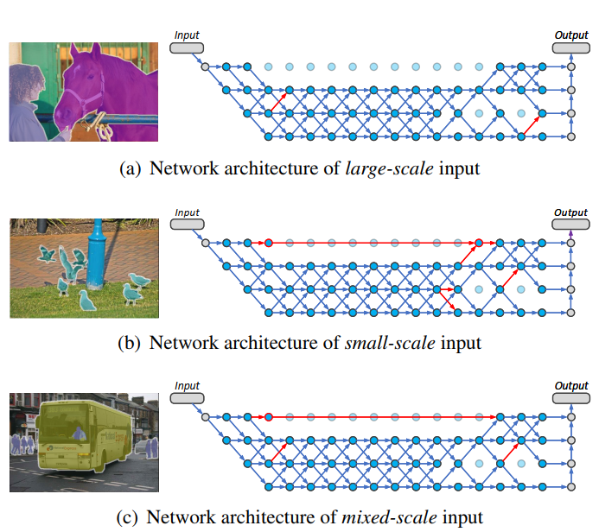
Introduction
Concept:
Different scale distributions of input, different routing forward paths.

Slide 4
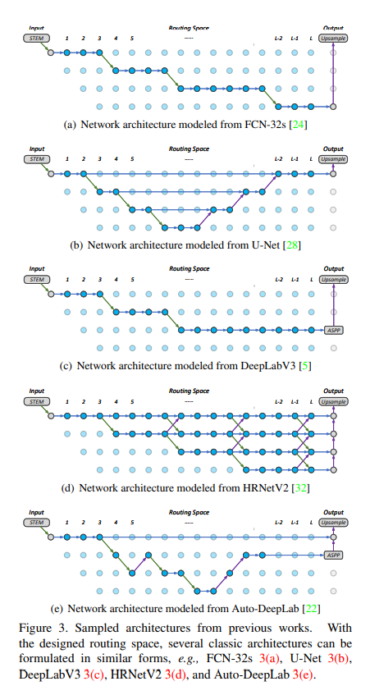
Introduction

Slide 5
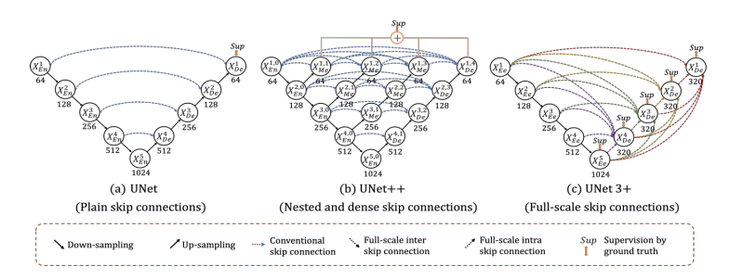
Method
Model structure :
Inspired by U-Net++ and UNet3+, I want use Full-scale Deep Supervision to adjust model width.

Slide 6
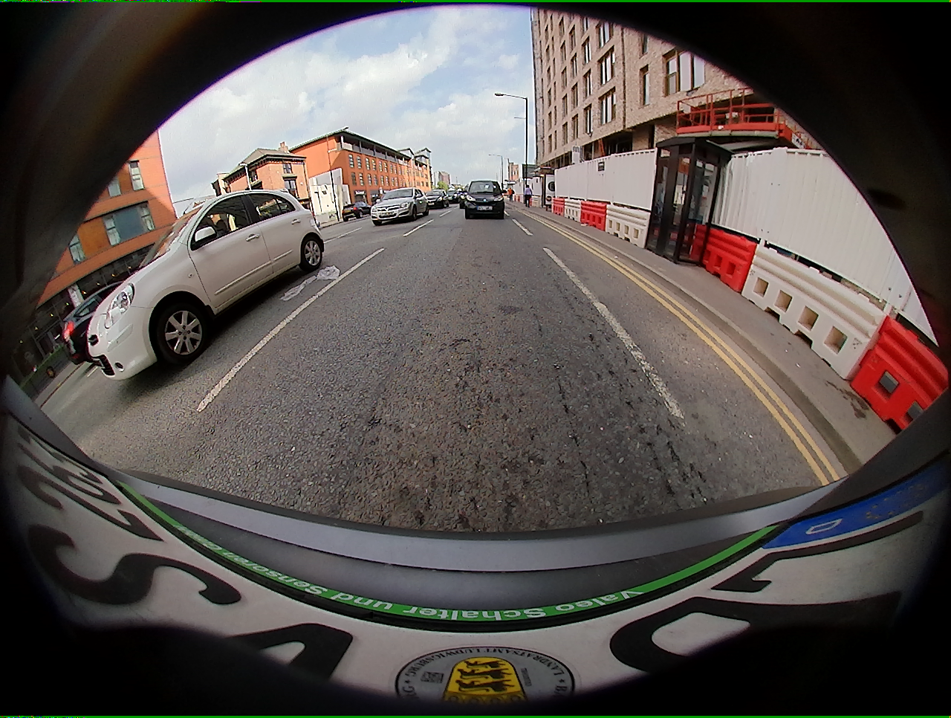
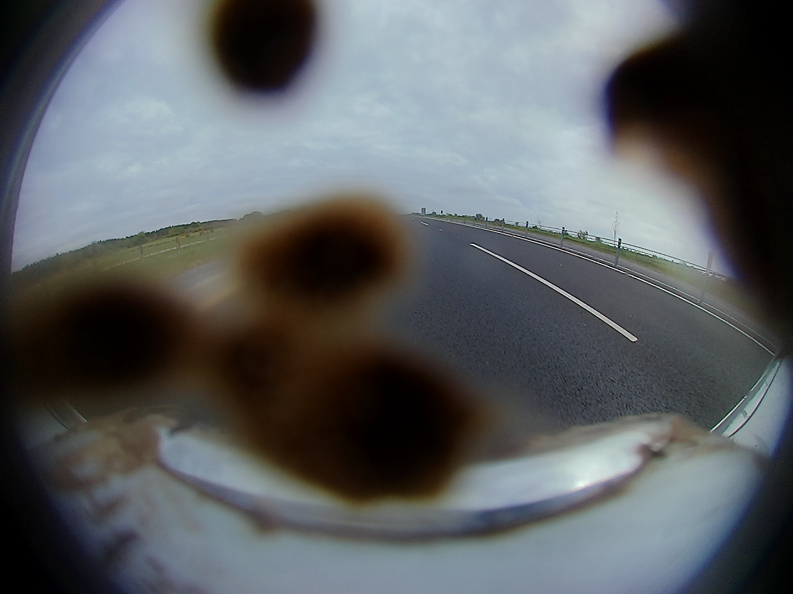
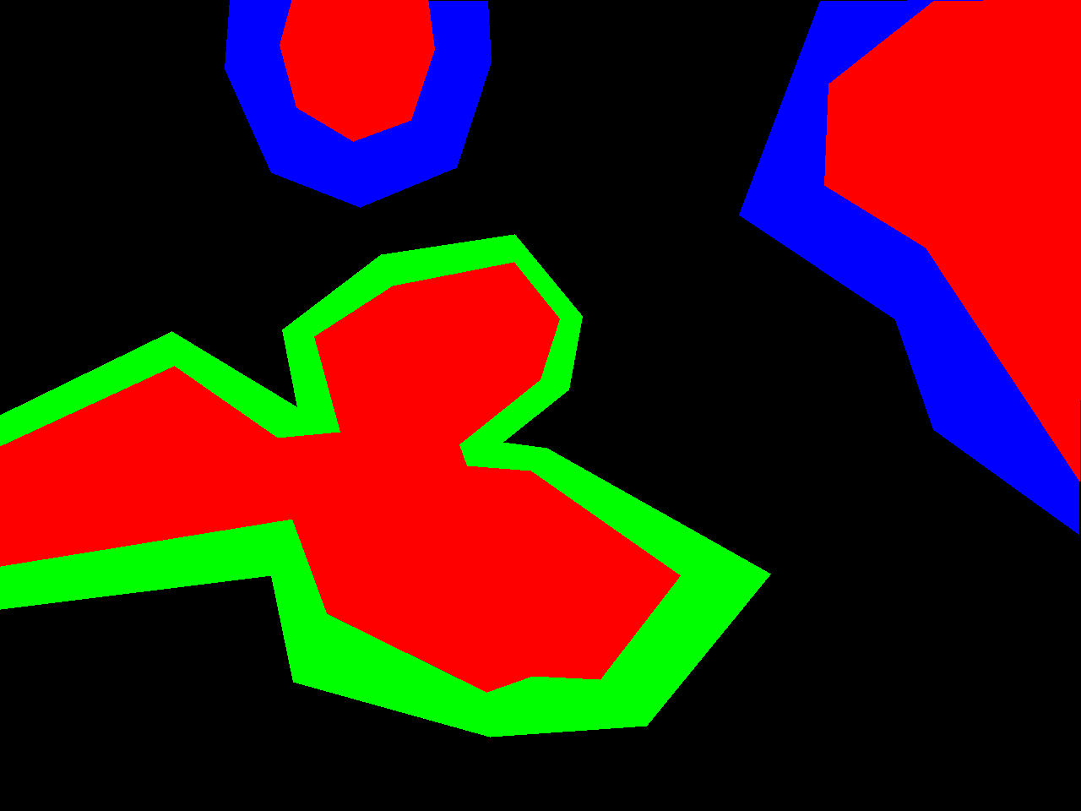
Method
Other :
Fine-grained Pruning, Coarse-grained Pruning, Quantization
Woodspace datasets (fish eye camera)
Loss function
Soiling lens image

Slide 7
Problem
Environment : Detection2, opencv
Time

Slide 8
Video
https://drive.google.com/file/d/1t89SIZAnwlmpvcchK9HowgO5_Y2NBVv9/view?usp=sharing

Slide 9
Thank You for Your Attention

